Slide 1
TB IO8 (TB004502) – Reverse polarity connector J32
ANBG-NV Adapter QA Team
October 29, 2026

Slide 2

Discipline 1
Form a Team
Discipline 2
Describe the Issue & Status
Discipline 3
Containment Action
Discipline 4
Describe the Root Cause
Discipline 5
Corrective Action
Discipline 6
Verify Effectiveness of Actions
Discipline 7
Preventive Action Plan
Discipline 8
Congratulate Your Team

Slide 3
Discipline 1
D1
Form a Team
D2
D3
D4
D5
D6
D7
D8
TEAM | NAME | CONTACT
Ops Head | Ming-Jie | ming-jie.fu@fii-foxconn.com
ME Manager | Guo Bin | bin.b.guo@fii-foxconn.com
ME Leader | Feliz | feliz.jy.zhang@fii-foxconn.com
ME AOI Leader | Sky | sky.dq.liu@fii-foxconn.com
QA Manager | Joshua He | joshua.jy.he@fii-foxconn.com
PQE Leader | Harry Chen | Harry.ws.chen@fii-foxconn.com
PQE Member | Shan Li | Ting-shan.li@fii-foxconn.com
PQA Leader | Andrew | andrew.hs.ding@fii-foxconn.com
PD Manager | Xin-Hong | xin.hong.zhang@fii-foxconn.com
PD Leader | Wen-Xin | wen-xin.chen@fii-foxconn.com
PE Manager | Mark | mark.ds.ruan@fii-foxconn.com
PE Leader | Tom | tom.ph.fan@fii-foxconn.com

Slide 4
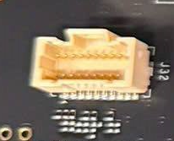
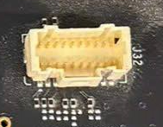
Discipline 2
Describe the Issue & Status
D1
D2
D3
D4
D5
D6
D7
D8
What
When
Where
Detect location: F06-2F- B34G (TE ware house)
P/N: TB IO8 (TB004502) –
SMT line: F06-1F-Line 19 (First MP/Bot side)
Reverse polarity connector J32
MO: 218452, MO Q’ty: 508 pcs
Issue finding time: 2026/10/28 10:51
TB IO8 (TB004502) – Reverse polarity connector J32
Who
TE Quan
Why
N/A
How many
Total DRF: 100% (508 pcs)
NG image
OK image

Slide 5
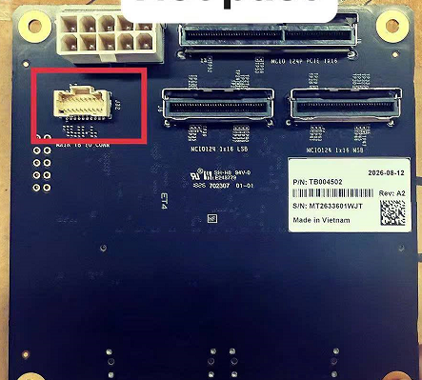
Discipline 2
Describe the Issue & Status
D1
D2
D3
D4
D5
D6
D7
D8
On 2026 Oct 28th 10:51 TE leader Hoang Van Quan assembly test board for the IO8 project and detected a reverse polarity issue at J32.
DRF: 100% (508 pcs)
MO: 218452, MO Q’ty: 508 pcs
Check this MO information:
Product run first time running a production line at SMT F06-1F-Line 19 (First MP/Bot side)
SMT time: 2026-08-07
Material PN: CON001653, Vendor: AMPHENOL.
NG image
OK image

Slide 6
Discipline 3
Containment Action
D3
D4
D5
D6
D7
D8
D1
D2
Conduct sorting at TE B34G WH found 100% NG (508 pcs). TE Quan, Done, 10/28.
Immediately stop line 19 and another line to check all material, no reverse polarity was found. SMT HeBin, Done, 10/28.
Conduct to check AOI image & alarm with another MO for this PN no reverse polarity was found. ME, Thuan, 10/28

Slide 7
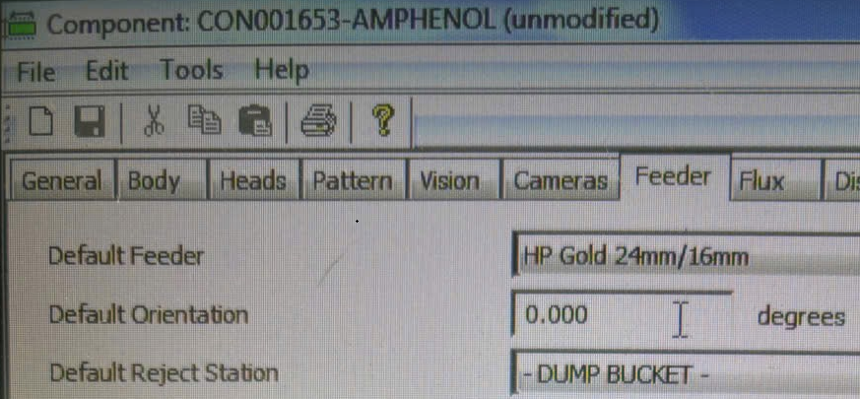
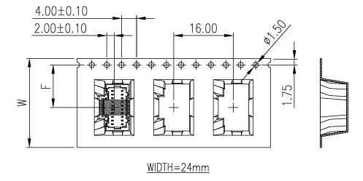
Discipline 4
Describe the Root Cause
D4
D5
D6
D7
D8
D1
D2
D3
Root cause:
Why J32 wrong polarity?
Check program set up and actual PN not map library
Program set up library polarity is 0°
Actual PN polarity is 180°
Why library with actual PN not map?
MO 119352 use MFR Amphenol polarity is DOWN (180°)
Check program from production NPI (Jan-2025) to MP (Apr-2026) only use MFR Molex, so program define library by Molex polarity is UP (0°)
Program set up Molex
Polarity is UP (0°)
Amphenol (G846A202100C1HR-NC): Actual polarity is DOWN(180°)

Slide 8
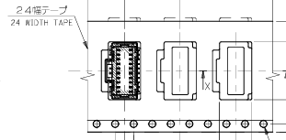
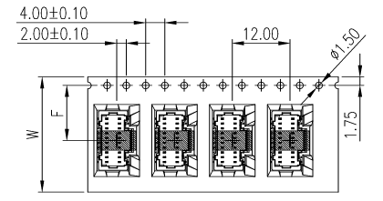
Discipline 4
Describe the Root Cause
D4
D5
D6
D7
D8
D1
D2
D3
Root cause:
1. Occurrence Cause
Why Molex and Amphenol have different polarity?
Molex: polarity is UP (0°)
Amphenol: polarity type 1 is DOWN (180°) and type 2 is UP (0°)
Type 1
DOWN (180°)
Type 2
UP (0°)
Molex
Polarity is UP (0°)
Amphenol (G846A202100C1HR-NC):

Slide 9
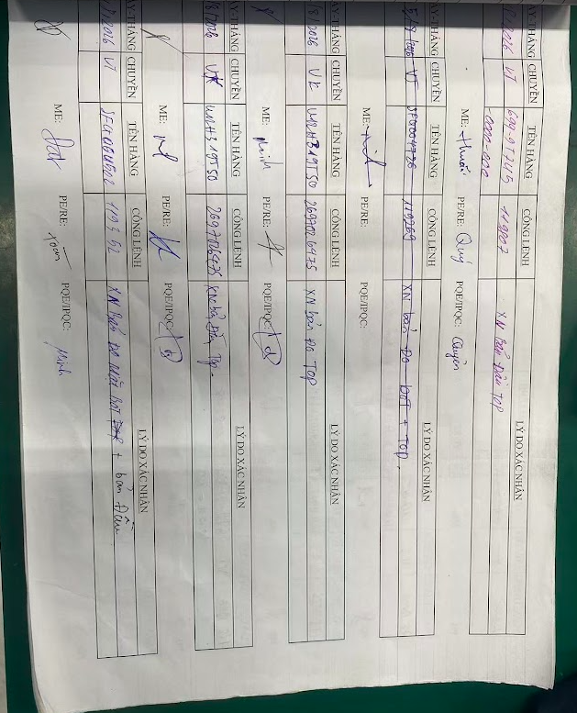
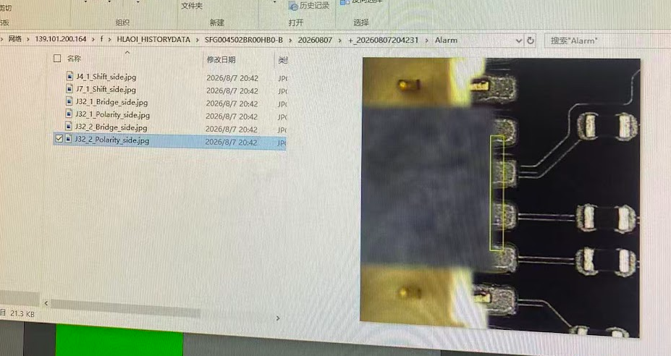
Discipline 4
Describe the Root Cause
D4
D5
D6
D7
D8
D1
D2
D3
Root cause:
2. Escape cause:
Why was the reverse polarity issue not detected during FAI/CFT confirmation?
1. Over-reliance on previous production experience
MO 1XXX had been produced multiple times using the same SMT program. Based on previous production experience, it was assumed that the program and component setup were correct, resulting in insufficient verification during the initial confirmation.
2. Failure to strictly follow the FAI confirmation procedure
Since other departments had already participated in and signed off the confirmation, the FAI/CFT verification was not conducted thoroughly. The required inspection items and confirmation steps were not fully followed.
3. Insufficient verification of connector polarity
Connector polarity was not verified against the manufacturer's datasheet, as its orientation was not clearly identifiable by visual inspection like IC components.
4. AOI inspection failure
AOI had the capability to detect reverse polarity, but the operator missed the detection.
AOI was not configured with an automatic line lock when 5 consecutive reverse polarity defects were detected.
AOI data
FAI record

Slide 10
Discipline 5
Corrective Action Plan
D2
D4
D5
D6
D7
D8
D1
D3
Add all part control MFR. Owner/ ME. Ying – Done
Feedback SQE to confirm with Amphenol only ship Type 2 for Foxconn. Owner/ SQE. Bin
AOI setting auto lock if detect 5 pcs reverse consecutive (Done)

Slide 11
Discipline 6
Verify Effectiveness of Actions
D5
D1
D2
D3
D4
D5
D6
D7
D8
D1
D2
D3
D4
D6
D7
D8
Verify the updated SMT program against the actual connector polarity and manufacturer's datasheet.
Conduct FAI/CFT re-confirmation to ensure all required inspection items are properly checked and signed off.
Verify connector polarity during trial production and confirm that no reverse polarity defects are found.
Verify AOI automatic line lock function when 5 consecutive reverse polarity defects are detected.
Monitor subsequent production and confirm no recurrence of the J32 reverse polarity issue.

Slide 12
Discipline 7
Preventive Action Plan
D1
D2
D3
D4
D5
D6
D7
D8
Strengthen FAI/CFT verification to ensure all required inspection items are fully checked before sign-off.
Require re-verification of SMT program settings and actual component polarity when reusing programs for new MO or production runs.
Update the FAI checklist and standardize connector polarity verification based on the manufacturer's datasheet, especially for connectors without clear visual polarity markings.

Slide 13
Discipline 8
Congratulate Your Team
D5
D6
D7
D8
D1
D2
D3
D4
Thank you!!!

Slide 14
Share · Collaborate · Thrive

